Slide 1
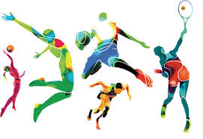
Sport

Slide 2
Football
Soccer
Gaelic football
Hurling
Camogie
Tennis
Darts
Pool
Snooker
Football pitch
Basketball
Basketball court
Hoops
Football jerseys
Team flags
Half time
referee
netball
baseball
hockey
GAA
Handball
American Football
Snooker
Football pitch
Basketball
Basketball court
Hoops
Football jerseys
Team flags

Slide 3
School

Slide 4
work
classroom
school bag
table
pencil
colours
uniform
Playground
bus
music
art
maths
shapes
numbers
letters
Friends
Playtime
PE
Rossecourt
shop
teachers
adults
children

Slide 5
breakfast

Slide 6
cereal
spoon
bowl
table
toast
butter
jam
marmalade
knife
fork
scrambled egg
boiled egg
fried egg
sausages
rashers
beans
porridge
Corn Flakes
Weetabix
Rice Krispies
Coco Pops

